Slide 1

Group Number : A4
Project Title
Sign language interpreter
SI .NO | Team members | USN
01. | Bhuvan Budavi | 02FE21BEC021
02. | Bhuvaneshwari Rajamane | 02FE21BEC022
03. | Darshan Gadade | 02FE21BEC028
04. | Rakshit Patil | 02FE21BEC067

Slide 2
Objective:
Develop a system to convert sign language to speech, providing a voice for disabled individuals to communicate with the broader society.

Slide 3
What is SVM?
Support Vector Machine or SVM is one of the most popular Supervised Learning algorithms, which is used for Classification as well as Regression problems. However, primarily, it is used for Classification problems in Machine Learning.
The goal of the SVM algorithm is to create the best line or decision boundary that can segregate n-dimensional space into classes so that we can easily put the new data point in the correct category in the future. This best decision boundary is called a hyperplane.
SVM chooses the extreme points/vectors that help in creating the hyperplane. These extreme cases are called as support vectors, and hence algorithm is termed as Support Vector Machine

Slide 4
What is CNN?
A convolutional neural network (CNN or convnet) is a subset of machine learning. It is one of the various types of artificial neural networks which are used for different applications and data types.
A CNN is a kind of network architecture for deep learning algorithms and is specifically used for image recognition and tasks that involve the processing of pixel data.
There are other types of neural networks in deep learning, but for identifying and recognizing objects, CNNs are the network architecture of choice.
This makes them highly suitable for computer vision (CV) tasks and for applications where object recognition is vital, such as self-driving cars and facial recognition.

Slide 5
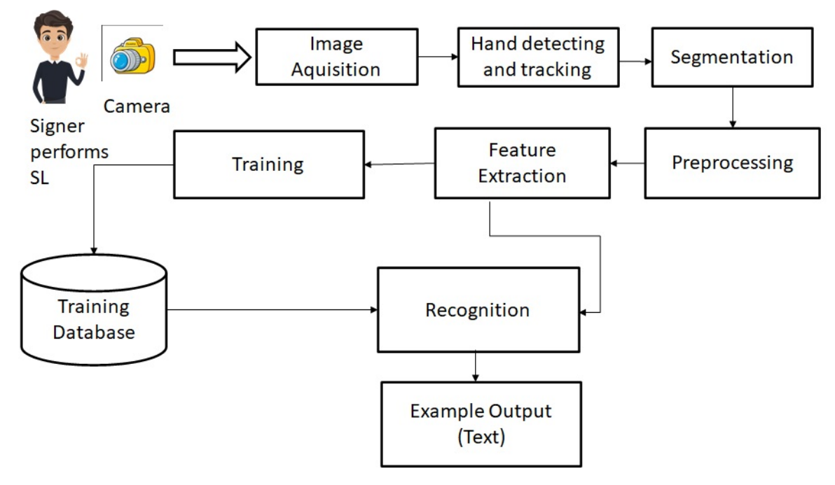
Flow Diagram:

Slide 6
Code Explanation: Data Extraction
Import Required Libraries like Numpy, Opencv, tensorflow, mediapipe
Initialize Variables: Initialize Hand detector module to detect the hands and then initialize offset and image size
Image Processing loop: Continuously capture the frames using the camera and hand detector module if hand is detected and then resize and center the image saved into a white canvas of Size “imgSize x imgSize”.
Image Saving: If S key is pressed the image is saved at the specified folder and then increment the counter for file naming.
Exit mechanism: If “q” is pressed then it releases the camera and exits the loop

Slide 7
Code Explanation: Execution
Import Required Libraries like Numpy, Opencv, tensorflow, mediapipe
Initialize Variables: Initialize Hand detector module to detect the hands and then initialize offset and image size and also the pretrained model
Image Processing loop: capture the hand using the camera and hand detector module if hand is detected using the pretrained model Classify the image and display the recognized sign that is associated with that value of hand.
Exit mechanism: If “q” is pressed then it releases the camera and exits the loop

Slide 8
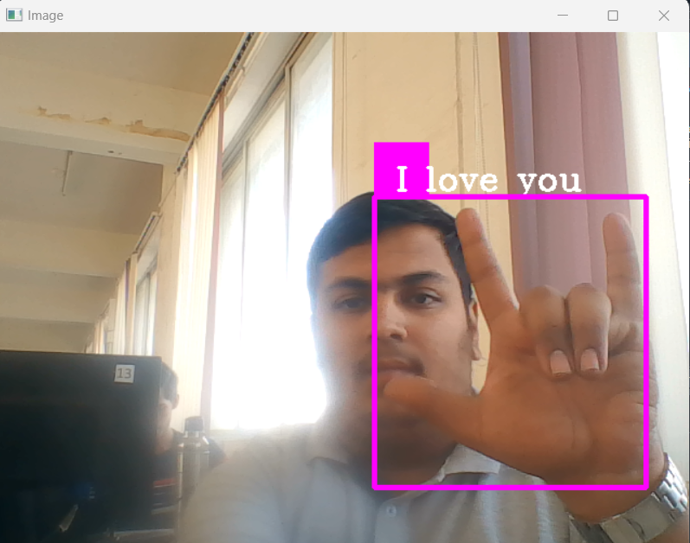
Output:

Slide 9
Future scope for gesture recognition:
Enhanced Accuracy: Improve model accuracy for a broader range of gestures through more diverse data and refined training.
2. Real-time Feedback: Provide immediate responses (audio/visual) based on recognized gestures, enhancing user interaction.
3. Gesture Synthesis: Explore generating meaningful actions from sequences of gestures for more complex interactions.
4. Adaptability: Optimize for diverse environments, lighting, and orientations for widespread applicability.
5. Expand Vocabulary: Recognize more gestures to support a richer set of commands or interactions.
6. VR/AR Integration: Extend gesture recognition to virtual and augmented reality for immersive experiences.

Slide 10
Refrences:
1. A Machine Learning Based Approach for the Detection and Recognition of Bangla Sign Language’ – 2016 Hasan M. , Sajith , & Dey M. 2016 International Conference on Medical Engineering, Health Informatics and Technology (MediTec).https://ieeexplore.ieee.org/abstract/document/7835387
Privacy-Preserving British Sign Language Recognition Using Deep Learning’- 2022 Hira Hameed , Muhammad Usman , Muhammad Zakir Khan , Amir Hussain , Hasan Abbas , Muhammad Ali Imran, and Qammer H. Abbasi 2022 44th Annual International Conference of the IEEE Engineering in Medicine & Biology Society (EMBC)
https://ieeexplore.ieee.org/iel7/9870821/9870822/09871491.pdf 3.
https://youtu.be/wa2ARoUUdU8
https://teachablemachine.withgoogle.com

Slide 11
Github Link:
Machine Learning Project files that include PPT, Report, Code.

Slide 12
THANK YOU

